Slide 1
ANSI SQL

Slide 2

Session Objectives
At the end of the session you will be able to
Describe the different types of functions
Describe the numeric, character, date functions
Describe the Aggregate functions
Describe the mathematical functions

Slide 3
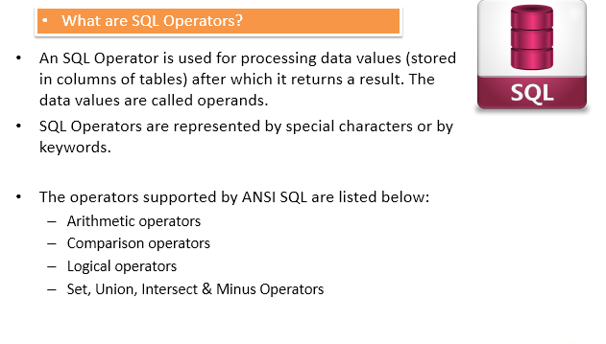
SQL Operators

Slide 4
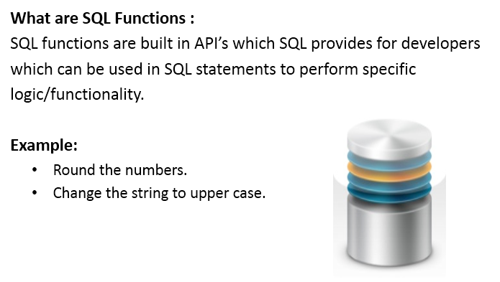
What are functions?

Slide 5
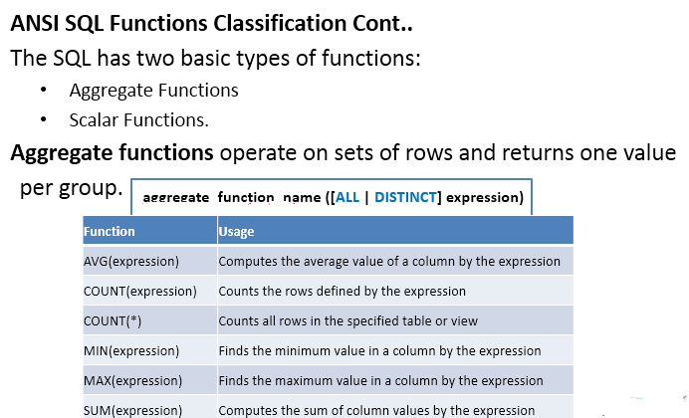
Aggregate functions

Slide 6
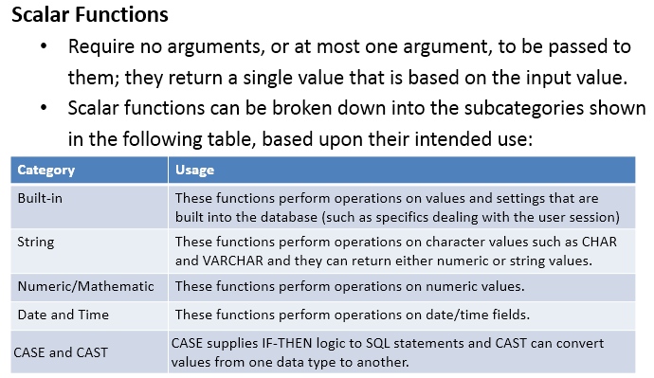
Scalar Functions

Slide 7
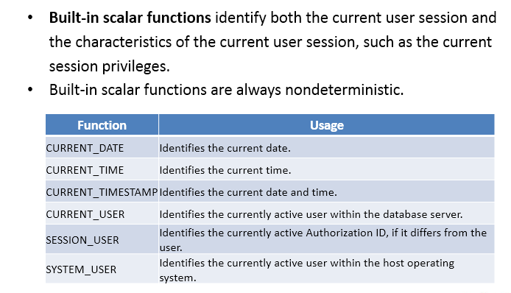
Built-in Scalar functions

Slide 8
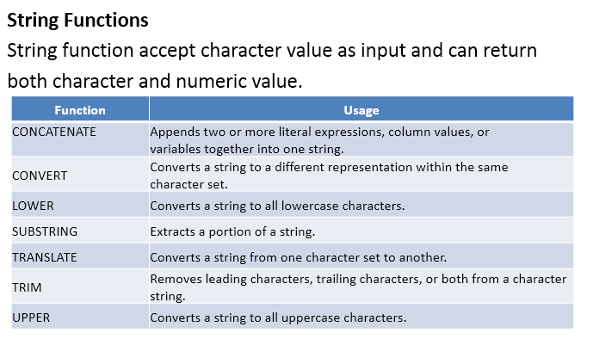
String functions

Slide 9
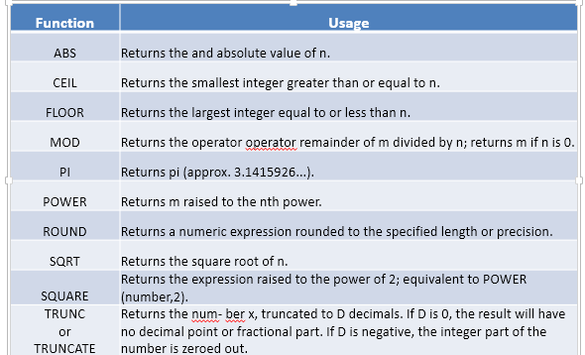
Numeric/Mathematical functions

Slide 10
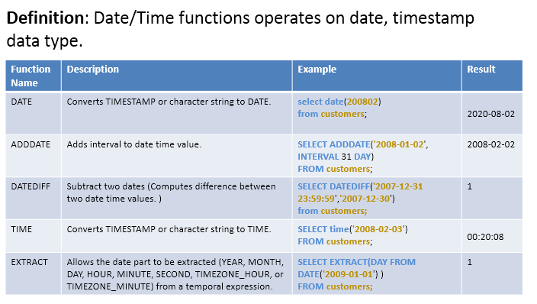
Date/Time functions

Slide 11
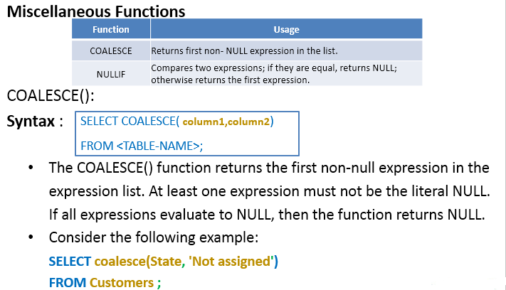
Miscellaneous functions

Slide 12
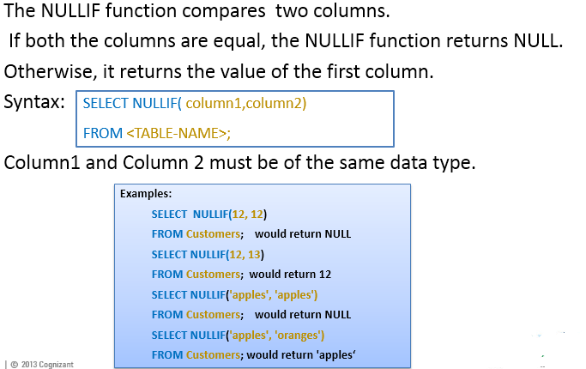
NULLIF functions

Slide 13
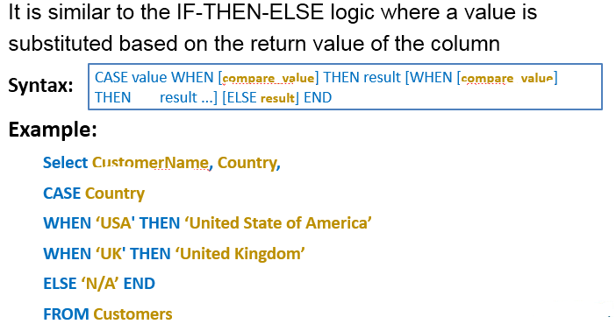
Control flow functions

Slide 14
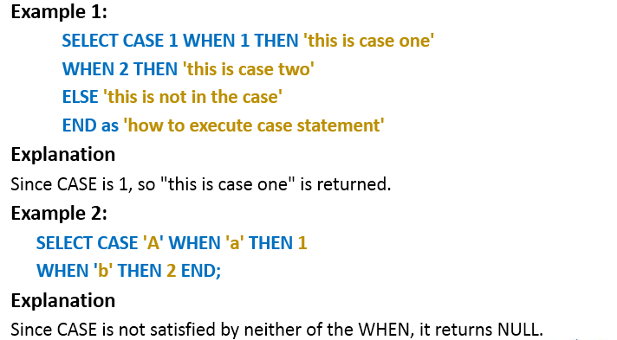
Control flow functions

Slide 15
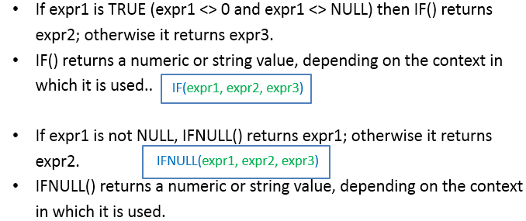
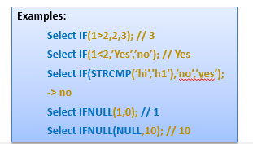
Control flow functions

Slide 16
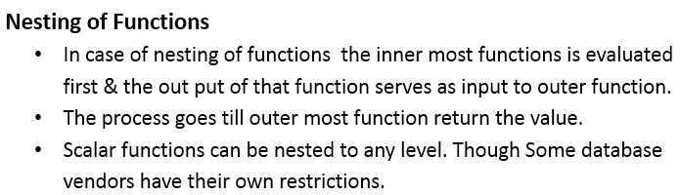
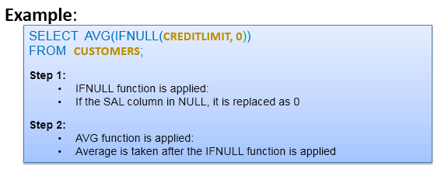
Nesting of functions

Slide 17
You have completed Sql Functions

